Slide 1
Multinomial Analysis of the Factors Influencing the Emptying Methods for Latrines in Ogun State, Nigeria.
By
Olasunkanmi O. OLAPEJU¹ and Adeyemi FAROTIMI

Slide 2
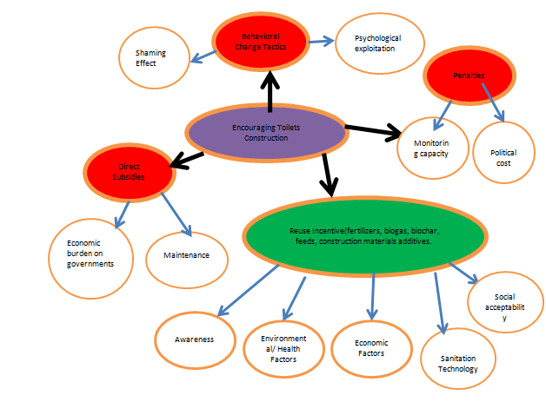
Global Strategies for Eradicating Open Defecation

Slide 3
Faecal Waste Within the Context of Circular Economy and Challenges
Faecal Waste have Applications in the Production of Biochar, Biogas, Construction Materials Addictives,& Agriculture
Households in the study area still use unsustainable(NRM) faecal waste management methods.
This does not just impinge on recoverability and reuse but also have health consequences.
Therefore, the study is an attempt to investigate the factors influencing latrines’ emptying methods in the study Area.

Slide 4
Methods
4 level –multistage sampling technique
5 sampling polling units in each of the senatorial sampling areas
11, 10, 12 households within 1km of the PUs in each of Likosi, Ogijo/Likosi ward Ilaro I; Sodeke/Isale‐Ijeun II
55, 50, and 60 questionnaires(160) were administered in 1.1:1.0:1.23, which reflects the variance in population of 1,250,435(33%), 1,112,761(30%), and 1,387,944(37%) for Ogun East, Ogun West and Ogun Central, respectively.

Slide 5
Demographic Analysis
The male gender accounts for the majority of respondents (64.2%) in the study area which is largely inhabited by Yoruba speaking population.
The absolute ages of respondents varied from 27 to 78 years, with a median age of 52 years and a standard deviation of 12.8.
Moreover, 79.5 % of respondents had secondary education as their highest educational qualification.
A great percentage of the respondents were actively engaged in the economy (97.4%) as artisans, civil servants and private sector employees.
However, the greatest number of respondents (45.9%) was ranked in the lower-middle class. Others ranked in the upper-medium class accounted for 26.1%, floating class (12.1%) and the upper class (4.8%).

Slide 6
Faecal Waste Emptying Methods
Emptying with the aid of manual emptiers (20.1%)
emptying with mechanical emptiers (31.5%)
and the non-recovery management (NRM) method (48.4%).

Slide 7
Analysis of The Factors Influencing Households’ Faecal Waste Emptying Methods
This multinomial logistic regression analysis adopted revealed key information:
The first category (Empty the Pit with the Aid of Manual Emptiers), at p-value 0.035, only the variable awareness of faecal waste reuse (DREUSE) was significant. Other variables and their categories had insignificant values.
For the second category, awareness of faecal waste reuse (DREUSE), Lower-middle-class Income category (INCCAT3) and Simple Pit latrines (LATTEC 2) at 0.018, 0.00, and 0.00, respectively were significant..
For the third category, only the sub-categories of income class such as floating class (INCCAT2) and upper-middle class(INCCAT4), both at 0.00, were significant.

Slide 8
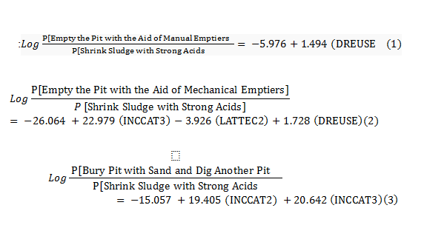
Significant Equations of the Models

Slide 9
Relative Risks Ratio
For the first category, the RRR for a unit increase in the scale of the awareness of faecal waste reuse (DREUSE) is 4.454 .
For the second category, the RRR for a unit increase in the scale of the awareness of faecal waste reuse (DREUSE) is 5.631 .
Moreover, the RRR of switching from the highest income class (INCCAT 4) level to the lower-middle level (INCCAT 3) is 9.547E9.
This means that the propensity of households to use mechanical emptying option versus shrinking sludge with strong acids increases by 9.547E9 from the highest income class(INCCAT 4) level to the lower-middle level(INCCAT 3).
Also, the RRR of switching from the most advanced latrine technology of WC-to Sewer (LATTEC 7) to simple pit latrine (LATTEC 2) is 0.2.
This means that the propensity of households to use mechanical emptying option versus shrinking sludge with strong acids decreases by 0.2 from WC-to Sewer (LATTEC 7) to simple pit latrine(LATTEC 2).
However, for the third category, the RRR of switching from the highest income class (INCCAT 4) level to the lower-middle level (INCCAT 3) is 9. 219E8.
The RRR of switching from the highest income class (INCCAT 4) level to the floating class (INCCAT 2) is 2.677E8.

Slide 10
Conclusion
As evident in the multinomial regression equations, awareness of reuse, income category, and latrine technology featured prominently as the most significant factors.
enlightenment campaigns aimed at sensitising households on the nexus between the reusability and emptying methods
Further, there is a need for municipal authorities to encourage the adoption of simple onsite low-cost technologies such as urine diversion dry toilets (UDDTs) that aids reuse.

